Slide 1
Animal Detection using Footprints
Team Details ​
P Phanindra Varshit (20EG105430)​
P Sidhartha (20EG105436)​
T Abhinav Reddy (20EG105444)​
Project Supervisor ​
Name : E Radha Krishnaiah​
Designation: Assistant Professor​

Slide 2
Introduction
Wild Animal detection using footprints in public places is used to enhance
safety and mitigate potential conflicts between humans and wild animals.​
This algorithm aims to detect the presence of wild animals in real time using the
footprints allowing authorities, individuals to take appropriate actions.​
The developing environment is Google Colab. ​
The application span in various domains like urban wildlife management, zoos
and sanctuaries, crop protection.​
The proposed system will first use Canny edge detection to identify the edges of
objects in an image. The edges of the objects will then be classified using PNN
algorithm.​

Slide 3
Problem Statement
The intrusion of wild animals into public places poses threats to both human well-being and animal welfare.​
To address this challenge, there is a need for an efficient and accurate system that can detect the presence of wild animals using footprints in real time and trigger appropriate responses to ensure safety and minimize conflicts.​
To protect humans from wild animals and vice-versa using canny edge method and PNN algorithm to improve :-​
Computational power​
Real time monitoring​
Enhanced security in public places​
Hazard detection​
Rapid alert generation​

Slide 4
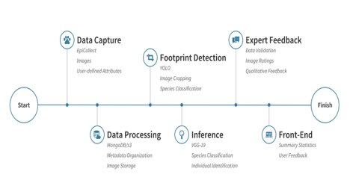
Proposed Method
❏ The proposed method is "Wild Animal Detection using Footprints."​
This methodology consists of:-​
​
Data Pre Processing​
Canny Edge Method​
PNN algorithm​
Alert Generation​
Canny Edge Method:-​
​
The Canny edge detector is an edge detection operator that uses a multi-stage algorithm to detect a wide range of edges in images.​

Slide 5
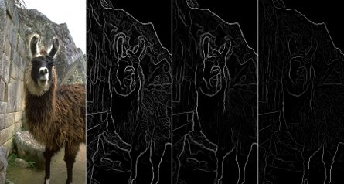
Proposed Method
The Canny edge detection algorithm is composed of 5 steps:​
​
Noise reduction - One way to get rid of the noise on the image, is by applying Gaussian blur to smooth it.​
Gradient Calculation - Gradient intensity and Edge direction​
Non Maximum Suppression - Performed to convert thick edges into thin edges​
Double threshold - The double threshold step aims at identifying 2 kinds of pixels: strong and weak​
Edge Tracking - Based on the threshold results, the hysteresis consists of transforming weak pixels into strong one​

Slide 6
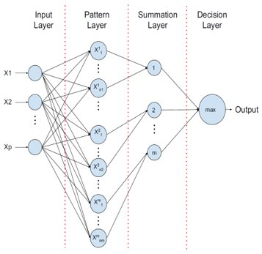
Proposed Method
PNN Algorithm :-​
It is a machine learning algorithm used for various pattern recognition tasks, including animal detection using footprints. PNN is particularly well suited for classification tasks and is based on the principles of Neural networks and Bayesian statistics.​
​
The PNN architecture has four layers:-​
​
Input Layer - p neurons represents the input vector and distribute it to next layer.​
Pattern Layer - During inference, each neuron calculates the Euclidian distance between input test vector and the training sample.​
Summation Layer - This layer computes the average of the output of the pattern units for each class.​
Output Layer - This layer selects the maximum value from the summation layer.​

Slide 7
Experiment Environment
Experiment environment that could be used to test a system for the project “Animal Detection using footprints” are:-
❏ Software - The system could be tested using a variety of
software frameworks in GoogleColab, such as Tensorflow, PyTorch,
OpenCV.
❏ Hardware - The hardware required for a PNN experiment will vary
depending on the size and complexity of the dataset, as well as the
desired training time and accuracy. However, in general, you will need
a computer with a powerful GPU and enough memory to store the
dataset and the trained model.
❏ Data - The system is trained and tested over 2000 images that
are representative of a real world conditions in which the system
will be deployed. The data set should include images of various
animal footprints in forests, wildlife sanctuaries and mountain
regions.

Slide 8
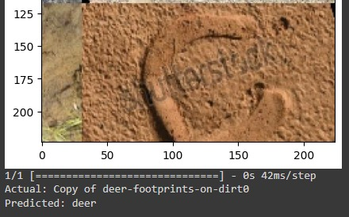
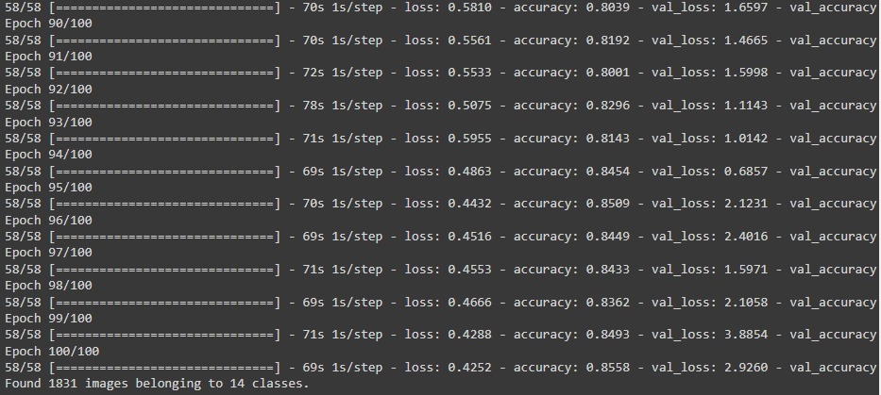
Experiment Screen shorts

Slide 9

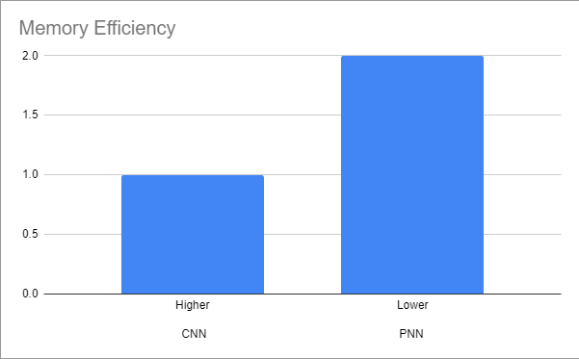
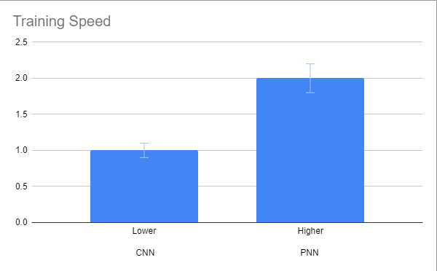
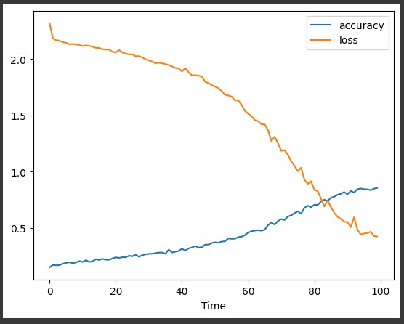
Experiment Results

Slide 10
Finding
We found that PNNs are more memory-efficient, faster to train, and more interpretable than CNNs for certain tasks. This makes PNNs a promising alternative to CNNs for applications where resources are limited or where interpretability is important.

Slide 11
Justification
Parameters
Memory Efficiency :- In the previously used methods, memory consumption was more. However, in the improved algorithm that is the PNN memory efficiency is more because PNN uses a fixed set of radial basis functions to represent data which is smaller compared to weight matrices used in CNN.
Training Speed :- Previously CNN was used and it took more time to train when compared to the improved value that is where PNN is used.
Interpretability :- CNN is a complex algorithm and is difficult to understand whereas PNN is quite simpler than CNN because it provides probability of datapoint of each class instead of giving a binary decision (e.g. : "cat" or "not cat")

Slide 12
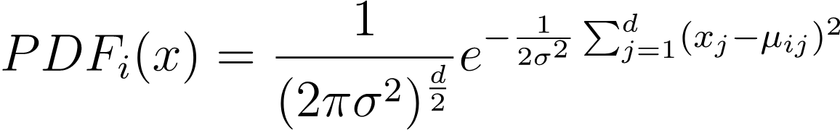
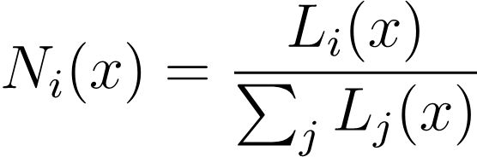
Mathematical formulas
Probability Density Function
Where:
PDFi (x) is the probability density function for class i given input x.
d is the dimensionality of the input vector.
σ is a parameter that controls the spread of the Gaussian distribution (often determined using cross-validation).
μij is the mean of the training samples in class i for the j-th feature.
Normalization

